Slide 1
Town of South Bristol
Presentation of the 2027 tentative budget

Slide 2
Revenues General Fund

Slide 3
Revenues Highway Fund

Slide 4

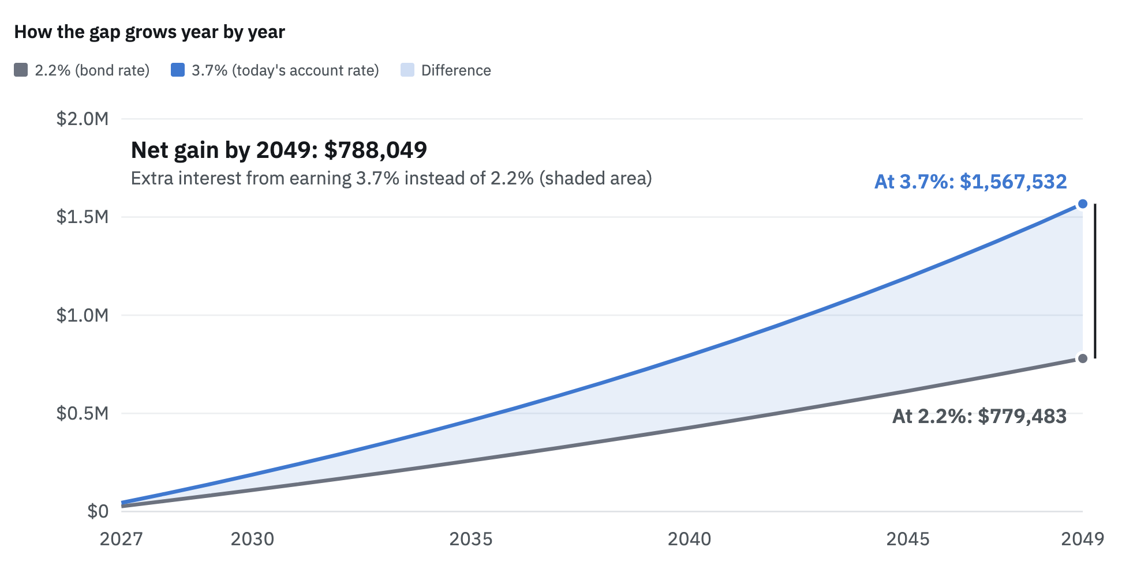



Why we don’t want to payoff bond in 2029

Slide 5
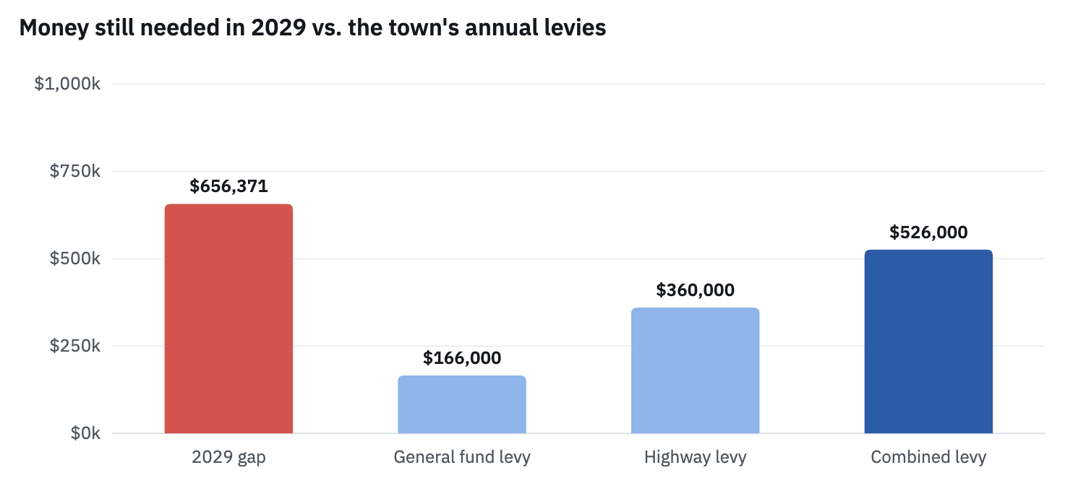
Payoff in 2029 would require an amount equal to 125% of our combined General & Highway Tax Levy
Why we don’t want to payoff bond in 2029

Slide 6
This Year:
Continue to Pay Bond from General Fund
Future Considerations:
Advantages of having a larger, more flexible reserve
  Take better advantage of fluctuations in interest rates
  More responsive to emergencies
Wide Range of Options for Repayment Over Long Term

Slide 7
3. Pay All From General
2. Pay 50/50
From Reserve & General
1. Pay More From Reserve, Less from General
4. Reconstitute
Restricted Reserve into a Larger, More Flexible Reserve
Several Possibilities for Long Term

Slide 8
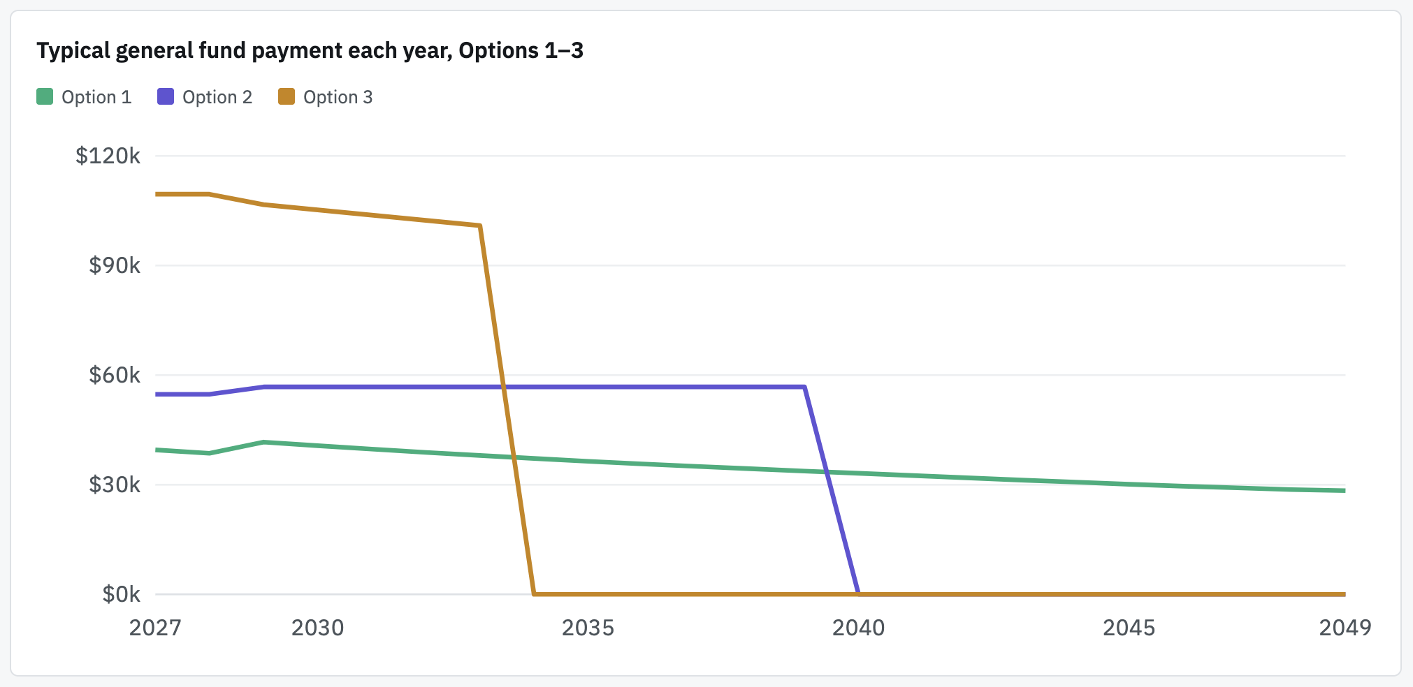
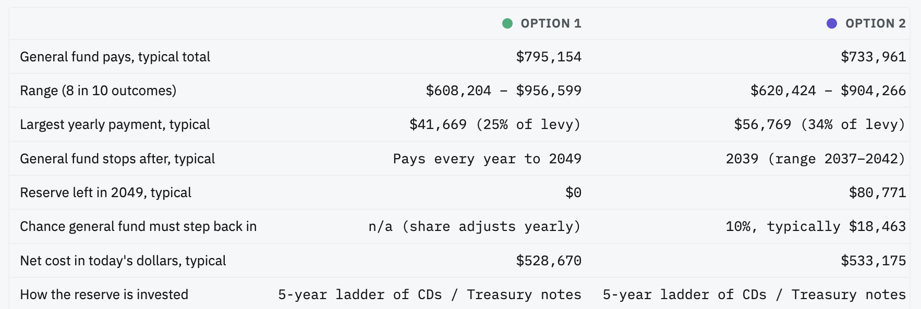
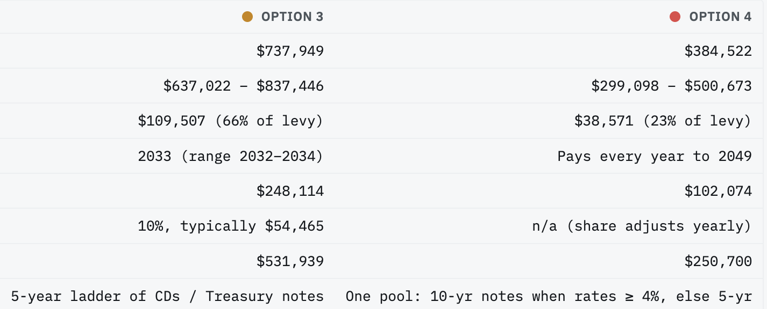
Several Possibilities for Long Term

Slide 9
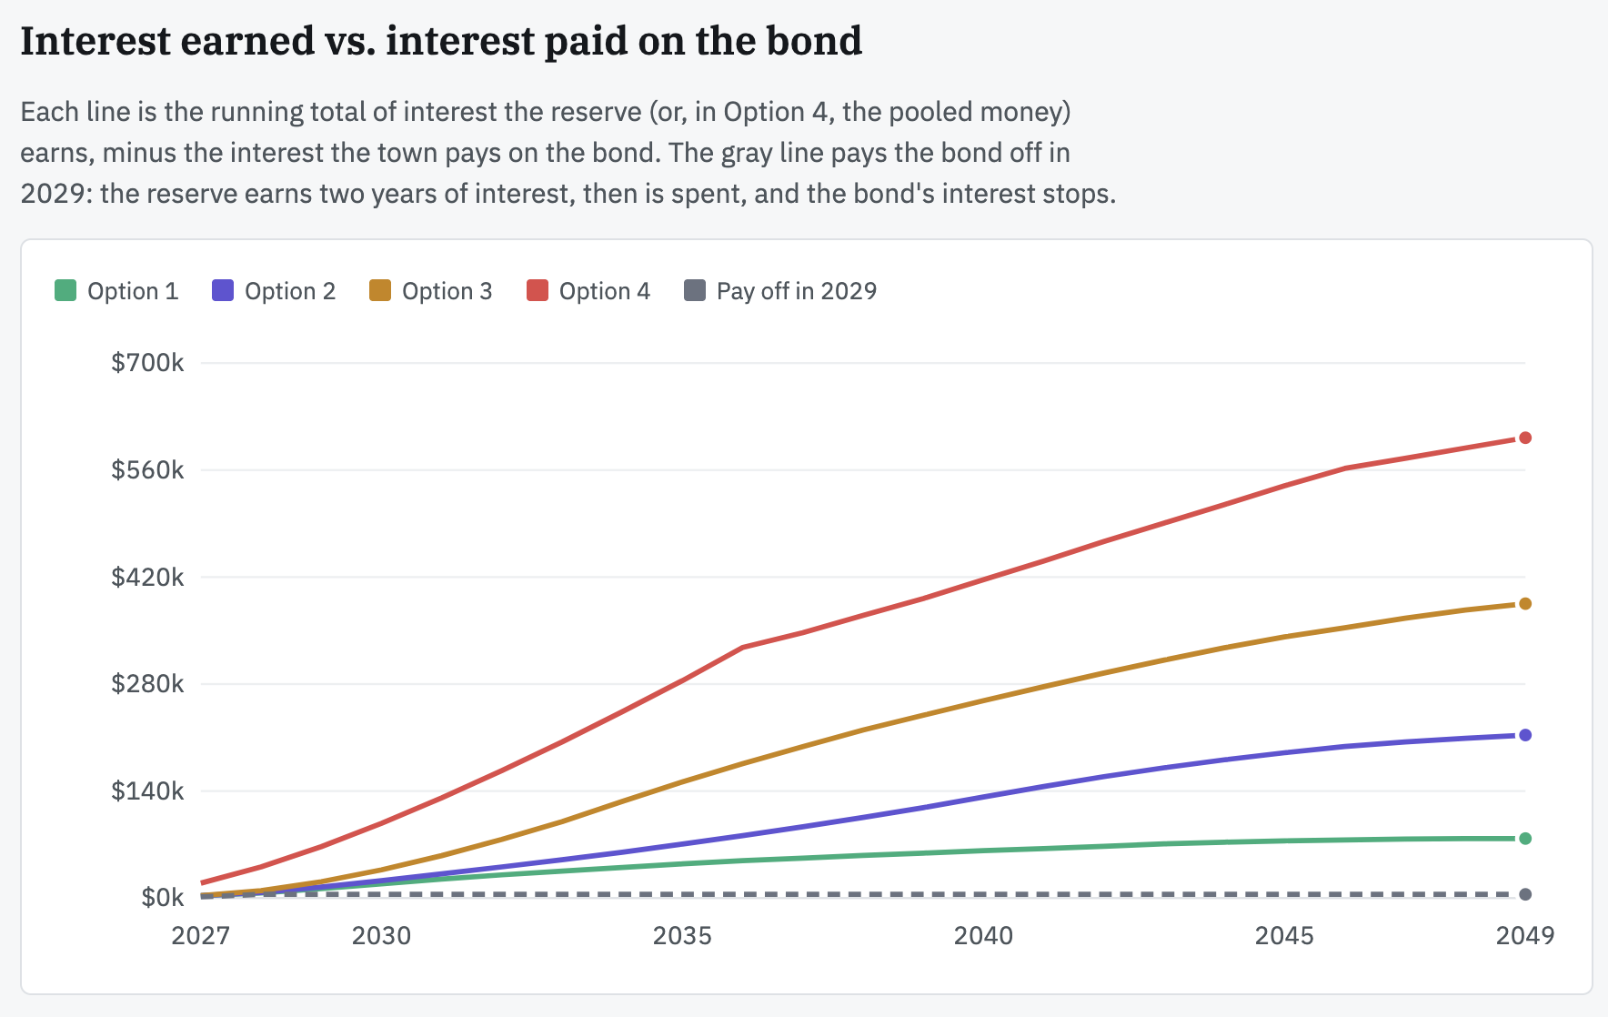
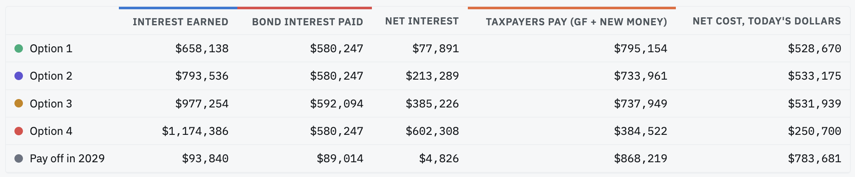
Several Possibilities for Long Term

Slide 10
Expenditures by Department: General Fund
Comparing 2026 (Budget) vs 2027 (Tent)

Slide 11
Town of South Bristol Tax Levy
No Changes in Tax Rates
From Budgeted Taxes | 2026 | 2027 | Tax Rate
A Fund (General) | $166,285 | $166,296 | .32/$1000 (no change)
DA Fund (Highway) | $360,021 | $360,021 | .69/$1000 (no change)
SF Fund (Fire) | $313,237 | $345,008
Total | $839,543 | $871,325
Under Tax Cap: | $9,420 | $2,052

Slide 12
2027 Tentative Budget
Questions and Discussion

